Slide 1


The Business Problem
Customer churn is a major challenge in the telecom industry, as losing customers directly impacts revenue and increases the cost of acquiring new ones. Instead of reacting after customers leave, companies need a proactive approach to identify which customers are at risk and take timely action. This project focuses on analyzing customer data to understand churn patterns and developing a clear strategy to reduce churn and protect long-term profitability.

Slide 2

Our Approach
2. Feature analysis
1. Data discovery
Contract type, monthly charges, payment method, tenure
Explore usage, billing, contract, support history
4. Segmentation
3. Risk modelling
Group: High, Medium, Low risk for targeted actions
Identify predictors and score customers

Slide 3





Key Findings
Month-to-month contracts
First-year customers
Electronic check payers
Most vulnerable
Higher churn probability
Higher leaving frequency
Higher monthly bills
Long-tenure customers
Correlates with churn
Much lower churn
These signals form the backbone of our early-risk detection.

Slide 4

Risk Segmentation
1
2
High Risk
Medium Risk
Very likely to churn • Highest CPL impact
Monitor & nudge • Moderate value
3
Low Risk
Retain & grow • Upsell opportunities

Slide 5


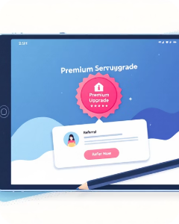
Targeted Retention Strategy
High Risk — Immediate
Medium Risk — Nurture
Low Risk — Grow
Premium upsells • Referral incentives • Advocacy programs
Targeted discounts • Fast support • Contract incentives
Loyalty rewards • Tailored plans • Engagement campaigns
Allocate resources where ROI is highest. Personalise offers by risk segment.

Slide 6
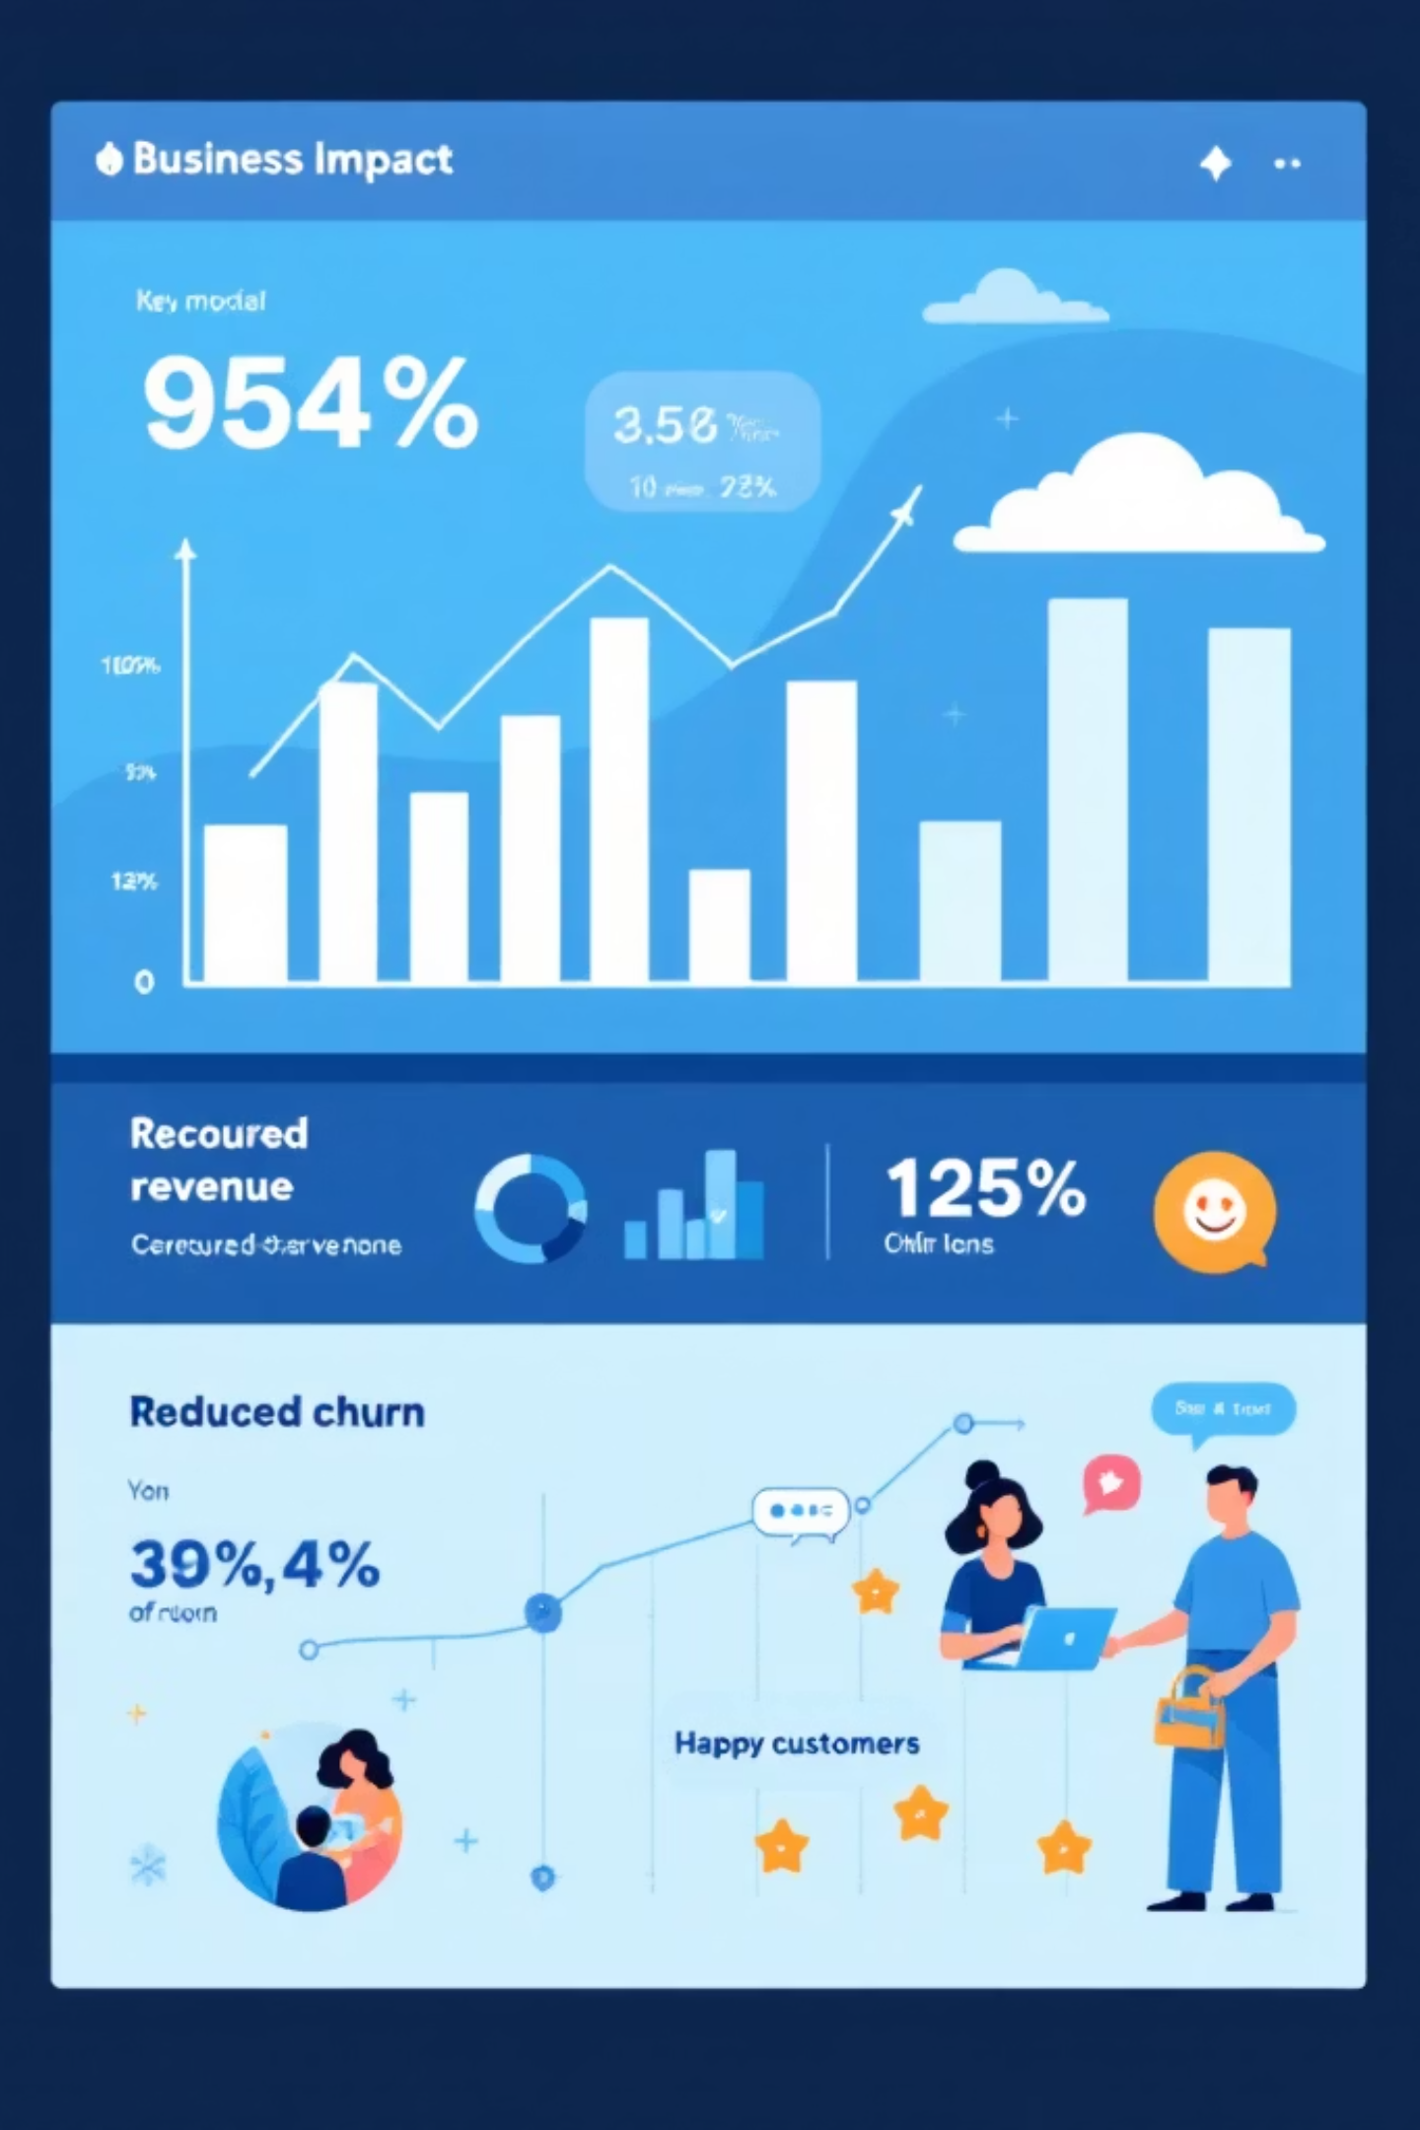

Expected Results
20%
↓30%
$1M
Retention lift
Churn reduction
Revenue saved
If 20% of high-risk retained
Lower monthly customer loss
Material impact to ARPU
Business outcomes
Save revenue by retaining high-value customers
Improve satisfaction & lifetime value
Spend retention budget more efficiently
Next steps: deploy scoring in pilot market → measure lift → scale

